Slide 1
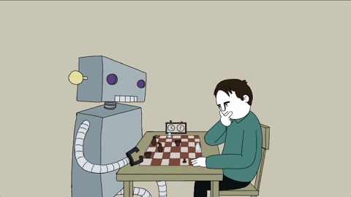
CSE4037
REINFORCEMENT LEARNING
DYNAMIC PROGRAMMING

Slide 2
Module No. 3
Deep Reinforcement Learning – 8 Hours
Dynamic Programming
Monte Carlo
Components
Control in Monte Carlo
LPI Convergence
Value Iteration
Policy Iteration
Q-Learning
Q-learning with deep networks, Double Q learning, replay memory, Deep NN Architectures for RL

Slide 3
Dynamic Programming
Reinforcement learning (RL) is a branch of machine learning that deals with learning from trial and error, based on rewards and penalties. Dynamic programming (DP) is a technique for solving complex problems by breaking them down into simpler subproblems, and reusing the solutions of the subproblems.
DP is a collection of algorithms that can solve a problem where we have the perfect model of the environment (i.e. probability distributions of any change happening in the problem setup are known) and where an agent can only take discrete actions.

Slide 4
Dynamic Programming
DP essentially solves a planning problem rather than a more general RL problem. The main difference, as mentioned, is that for an RL problem the environment can be very complex and its specifics are not known at all initially.

Slide 5
Why learn dynamic programming?
Dynamic programming can help find optimal solutions to planning problems faced in the industry, with an important assumption that the specifics of the environment are known. DP presents a good starting point to understand RL algorithms that can solve more complex problems.

Slide 6
Motorbike Rental company
Sunny manages a motorbike rental company in Ladakh. Being near the highest motorable road in the world, there is a lot of demand for motorbikes on rent from tourists. Within the town he has 2 locations where tourists can come and get a bike on rent. If he is out of bikes at one location, then he loses business.

Slide 7
Motorbike Rental company
Bikes are rented out for Rs 1200 per day and are available for renting the day after they are returned.
Sunny can move the bikes from 1 location to another and incurs a cost of Rs 100
With experience Sunny has figured out the approximate probability distributions of demand and return rates.
Number of bikes returned and requested at each location are given by functions g(n) and h(n) respectively. In exact terms the probability that the number of bikes rented at both locations is n is given by g(n) and probability that the number of bikes returned at both locations is n is given by h(n)

Slide 8
Motorbike Rental company
The problem that Sunny is trying to solve is to find out how many bikes he should move each day from 1 location to another so that he can maximise his earnings.
Here, we exactly know the environment (g(n) & h(n)) and this is the kind of problem in which dynamic programming can come in handy. Similarly, if you can properly model the environment of your problem where you can take discrete actions, then DP can help you find the optimal solution.

